Slide 1
Output Primitives (contd)
Instructor:
R. Das (Sarmah)

Slide 2
Other Helpful Formulas
Length of line segment between P₁ and P₂:
L = sqrt[ (x₂-x₁)² + (y₂-y₁)² ]
Midpoint of a line segment between P₁ and P₃:
P₂ = ( (x₁+x₃)/2 , (y₁+y₃)/2 )
Two lines are perpendicular iff
1) M₁ = -1/M₂
or
2) Cosine of the angle between them is 0.

Slide 3
Parallel Line Algorithms
The line-generating algorithms determines pixel positions sequentially.
Parallel processing and its advantages
Calculating multiple pixel positions along a line path simultaneously (partitioning the computations among the various processors available. )
take advantage of multiple processors.
set up the processing so that pixel positions can be calculated efficiently in parallel.
An important consideration in devising a parallel algorithm is to balance the processing load among the available processors.

Slide 4
Given n_{p} processors, set up a parallel Bresenham line algorithm by subdividing the line path into n_{p} partitions. simultaneously generating line segments in each of the subintervals.
For a line with slope 0 < m < 1 and left endpoint ( x₀ , y₀ ), we partition the line along the positive x direction. The distance between beginning x positions of adjacent partitions can be calculated as
where ∆x is the width of the line, and the value for partition width ∆x_{p} is computed using integer division. Numbering the partitions, and the processors, as 0,1, 2, up to n_{p} - 1, we calculate the starting x coordinate for the k^{th} partition as

Slide 5
we have n_{p} = 4 processors, with ∆x = 15, the width of the partitions is 4 and the starting x values for the partitions are x₀ , x₀ ₊ ₄, x₀ ₊ ₈, and x₀ ₊ ₁₂.
With this partitioning scheme, the width of the last (rightmost) subinterval will be smaller than the others in some cases.
In addition, if the line endpoints are not integers, truncation errors can result in variable width partitions along the length of the line.

Slide 6
A final stage in the implementation procedures for line segments and other objects is to set the frame-buffer color values.
Scan-conversion algorithms generate pixel positions at successive unit intervals, incremental operations can also be used to access the frame buffer efficiently at each step of the scan-conversion process.

Slide 7
Loading the frame buffer
Suppose the frame buffer array is addressed in row major order and that pixel positions are labeled from (0, 0) at the lower-left screen corner to (x max , y max ) at the top-right corner.
For a bilevel system (one bit per pixel), the frame-buffer bit address for pixel position ( x , y ) is calculated as

Slide 8
Moving across a scan line, we can calculate the frame-buffer address for the pixel at ( x + 1, y ) as the following offset from the address for position ( x , y ):
Stepping diagonally up to the next scan line from ( x , y ),we get to the frame-buffer address of ( x + 1, y + 1) with the calculation
where the constant x_{max} + 2 is precomputed once for all line segments.
Each of the address calculations involves only a single integer addition.

Slide 9
Setting frame buffer value
Methods for implementing these procedures depend on the capabilities of a particular system and the design requirements of the software package.
With systems that can display a range of intensity values for each pixel, frame-buffer address calculations include pixel width (number of bits), as well as the pixel screen location.

Slide 10
Curve Functions
One method is approximate it using a poly-line.
Just locate a set of points along the curve path and connect the points with straight-line segments.
More line sections =>the smoother the appearance of the curve.
A third alternative is to write our own
curve-generation functions
Illustration of various poly-line displays that could
be used for a circle segment.
A circular arc approximated with
(a) three straight-line segments,
(b) six line segments, and
(c) twelve line segments.

Slide 11
Properties of Circle
A circle is a set of points that are all at a given distance r from a center position ( x_{c} , y_{c} ).
For any circle point ( x , y ), this distance relationship is expressed by the Pythagorean theorem in Cartesian coordinates as
We could use this equation to calculate the position of points
on a circle circumference by stepping along the x axis in unit
steps from x_{c} - r to x_{c} + r and calculating the corresponding
y values at each position as

Slide 12
Properties of Circle
But this is not the best method for generating a circle.
One problem with this approach is that it involves considerable computation at each step. Moreover, the spacing between plotted pixel positions is not uniform.
We could adjust the spacing by interchanging x and y. But this simply increases the computation and processing required by the algorithm.
Upper half of a circle plotted with ( x c , y c ) = (0, 0).

Slide 13
A Simple Circle Drawing Algorithm (cont…)

Slide 14
A Simple Circle Drawing Algorithm (cont…)
However, unsurprisingly this is not a brilliant solution!
Firstly, the resulting circle has large gaps where the slope approaches the vertical
Secondly, the calculations are not very efficient
The square (multiply) operations
The square root operation – try really hard to avoid these!
We need a more efficient, more accurate solution

Slide 15
Properties of Circles
Another way to eliminate the unequal spacing shown in Fig. is to calculate points along the circular boundary using polar coordinates r and Theta.
Expressing the circle equation in parametric polar form yields the pair of equations

Slide 16
Properties of Circles
When a display is generated with these equations using a fixed angular step size, a circle is plotted with equally spaced points along the circumference.
To reduce calculations, we can use a large angular separation between points along the circumference and connect the points with straight-line segments to approximate the circular path.
For a more continuous boundary on a raster display, set the angular step size at 1/r . This plots pixel positions that are approximately one unit apart. Although polar coordinates provide equal point spacing, the trigonometric calculations are still time consuming.

Slide 17
Polar co-ordinates for a circle
But, note that circle sections in adjacent octants within one quadrant are symmetric with respect to the 45 deg line dividing the to octants
Thus we can generate all pixel positions around a circle by calculating just the points within the sector from x=0 to x=y
This method is still computationally expensive

Slide 18
Properties of Circle
Reduce computations by considering the symmetry of circles.
The shape of the circle is similar in each quadrant.
Determine the curve positions in the first quadrant, generate the circle section in the second quadrant of the xy plane by noting that the two circle sections are symmetric with respect to the y axis.
And circle sections in the third and fourth quadrants can be obtained from sections in the first and second quadrants by considering symmetry about the x axis. We can take this one step further and note that there is also symmetry between octants. Circle sections in adjacent octants within one quadrant are symmetric with respect to the 45 line dividing the two octants.

Slide 19
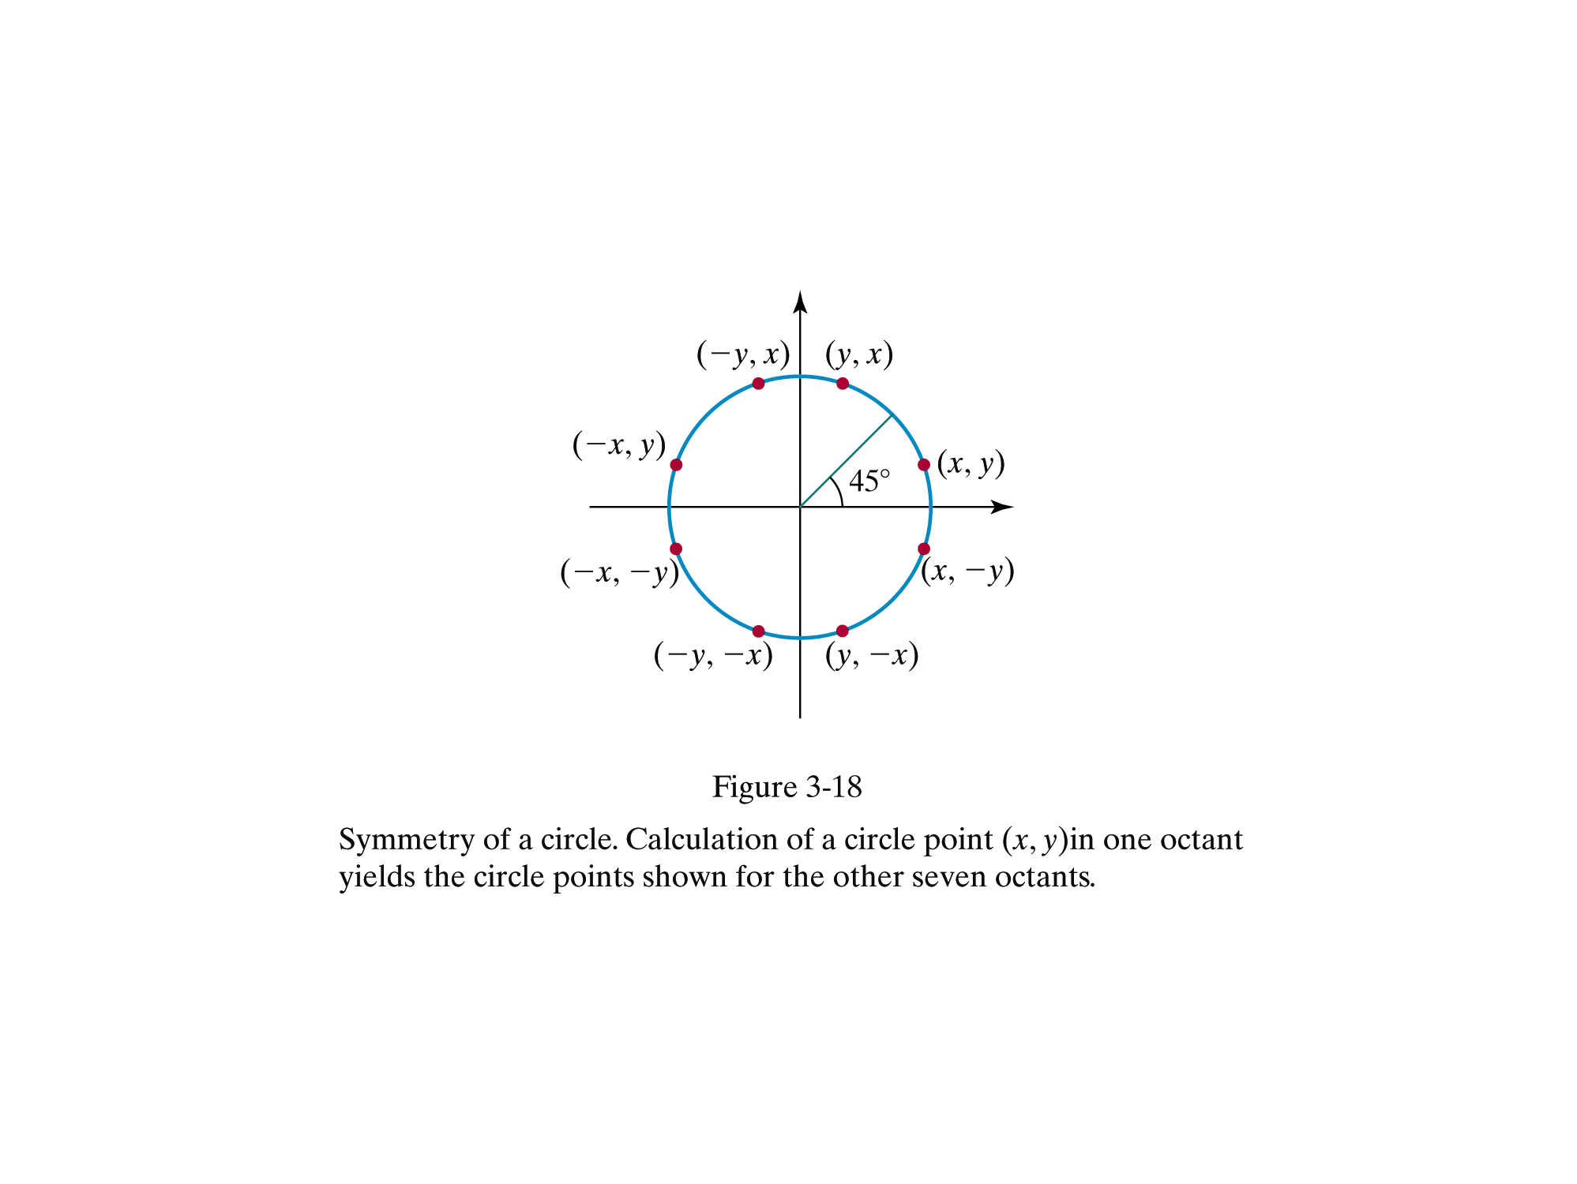

Slide 20
Midpoint Circle Algorithm
Along a circle section from x = 0 to x = y in the 1st quadrant, the slope (m) of the curve varies from 0 to -1.0
i.e. we can take unit steps in the +ve x direction over the octant & use decision parameter to determine which 2 possible positions is vertically closer to the circle path
Positions in the other 7 octants are obtained by symmetry

Slide 21
Optimisation and speed-up
Symmetry of a circle can be used
Calculations of point coordinates only for a first one-eighth of a circle
(-x,y)
(x,y)
(-y,x)
(y,x)
(-y,-x)
(y,-x)
(-x,-y)
(x,-y)

Slide 22
Properties of Circle
Determining pixel positions along a circle circumference using symmetry and either or
still requires a good deal of computation.
The Cartesian equation involves multiplications and square root calculations, while the parametric equations contain multiplications and trigonometric calculations.
More efficient circle algorithms are based on incremental calculation of decision parameters, as in the Bresenham line algorithm, which involves only simple integer operations.

Slide 23
Properties of Circle
Bresenham’s line algorithm for raster displays is adapted to circle generation by setting up decision parameters for finding the closest pixel to the circumference at each sampling step.
The circle equation is nonlinear, so that
square root evaluations would be required to compute pixel distances from a circular path.
Bresenham’s circle algorithm avoids these square-root calculations by comparing the squares of the pixel separation distances.

Slide 24
Properties of Circle
The idea in this approach is to test the halfway position between two pixels to determine if this midpoint is inside or outside the circle boundary.
This method is more easily applied to other conics; and for an integer circle radius, the midpoint approach generates the same pixel positions as the Bresenham circle algorithm.

Slide 25
Midpoint Circle Algorithm
As in raster algorithm, we sample at unit intervals & determine the closest pixel position to the specified circle path at each step
For a given radius, r and screen center position (x_{c},y_{c}) , we can set up our algorithm to calculate pixel positions around a circle path centered at the coordinate origin (0,0)
Each calculated position (x, y) is moved to its proper screen position by adding x_{c} to x and y_{c} to y

Slide 26
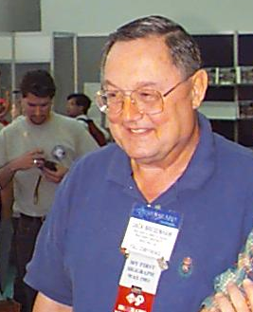
Mid-Point Circle Algorithm
Similarly to the case with lines, there is an incremental algorithm for drawing circles – the mid-point circle algorithm
In the mid-point circle algorithm we use eight-way symmetry so we only ever calculate the points for the top right eighth of a circle, and then use symmetry to get the rest of the points
The mid-point circle algorithm was developed by Jack Bresenham, who we heard about earlier. Bresenham’s patent for the algorithm can be viewed here.

Slide 27
Mid-Point Circle Algorithm
Assume that we have just plotted point (x_{k}, y_{k})
The next point is a choice between (x_{k}+1, y_{k}) and (x_{k}+1, y_{k}-1)
We would like to choose the point that is nearest to the actual circle
So how do we make this choice?
(x_{k}, y_{k})
(x_{k}+1, y_{k})
(x_{k}+1, y_{k}-1)

Slide 28
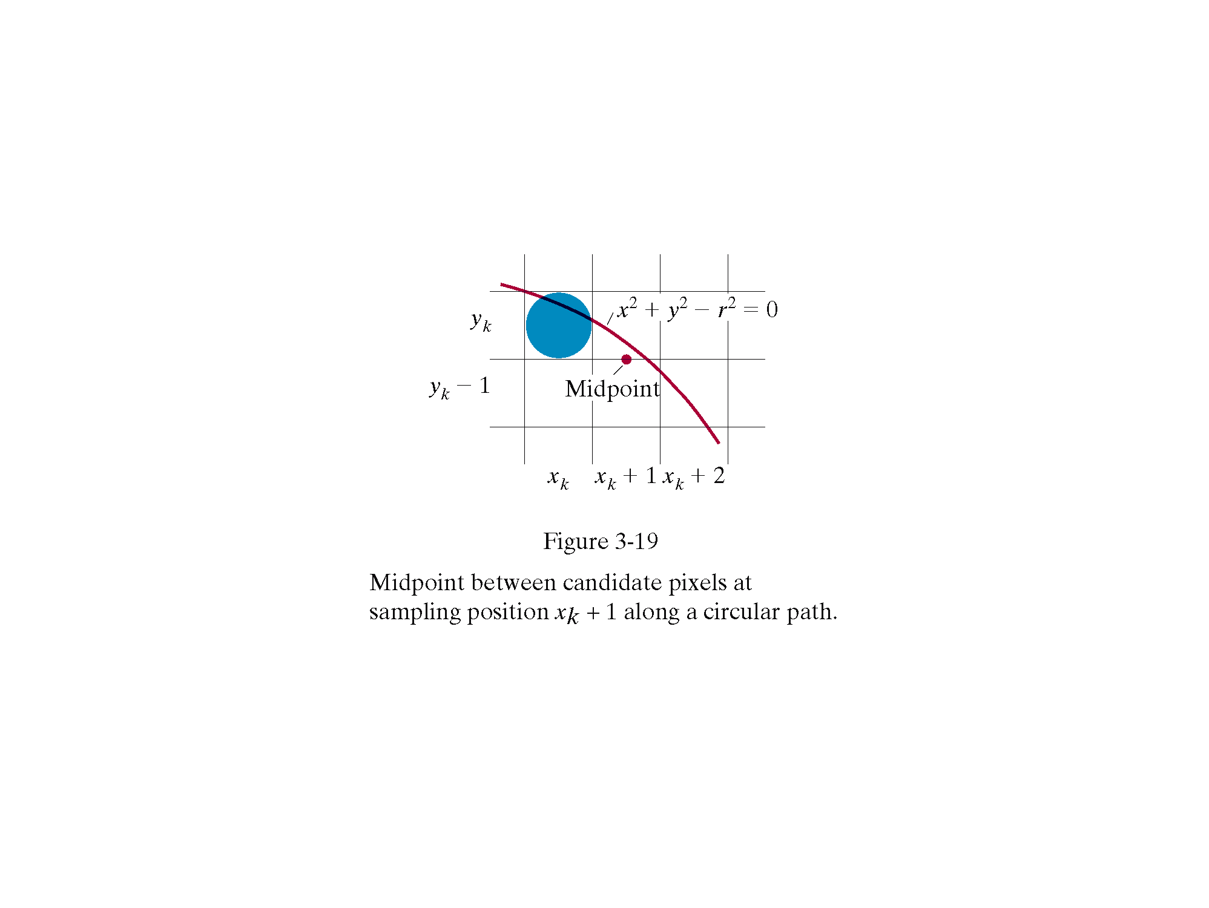

Slide 29
Midpoint Circle Algorithm
Consider current position (x_{k}, y_{k})
next point position is (x_{k}+1, y_{k}) or (x_{k}+1, y_{k}-1)?
y_{k}
y_{k-1}
y_{k}
Circle path
y_{k-1}
x_{k}
x_{k}
x_{k+1}
x_{k+2}
Midpoint

Slide 30
Mid-Point Circle Algorithm
Let’s re-jig the equation of the circle slightly to give us:
The equation evaluates as follows:
By evaluating this function at the midpoint between the candidate pixels we can make our decision
y_{k}
x²+y²-r²=0
y_{k-1}
Midpoint between candidate pixels at sampling position x_{k}+1 along a circular path
Midpoint
x_{k}
x_{k+1}
x_{k+3}

Slide 31
Mid-Point Circle Algorithm
Assuming we have just plotted the pixel at (x_{k},y_{k}) so we need to choose between (x_{k}+1,y_{k}) and (x_{k}+1,y_{k}-1)
Our decision variable can be defined as:
If p_{k} < 0 the midpoint is inside the circle and the pixel at y_{k} is closer to the circle
Otherwise the midpoint is outside and y_{k}-1 is closer

Slide 32
Mid-Point Circle Algorithm
To ensure things are as efficient as possible we can do all of our calculations incrementally
First consider:
or:
where y_{k+1} is either y_{k} or y_{k}-1 depending on the sign of p_{k}

Slide 33
Mid-Point Circle Algorithm
The first decision variable is given as: (x_{o}, y_{o})=(0,r)
If radius r is specified as an integer, we can round p₀ to p₀ = 1-r
Then if p_{k} < 0 then the next decision variable is given as:
If p_{k} > 0 then the decision variable is:

Slide 34
Midpoint Circle Algorithm
Increments for obtaining P_{k+1}:
2x_{k+1}+1 if p_{k} is negative
2x_{k+1}+1-2y_{k+1} otherwise
Note that following can also be done incrementally:
2x_{k+1} = 2x_{k} +2
2 y_{k+1} = 2y_{k} – 2
At the start position (0,r) , these two terms have the values 2 and 2r-2 respectively

Slide 35
The Mid-Point Circle Algorithm
Input radius r and circle centre (x_{c}, y_{c}), then set the coordinates for the first point on the circumference of a circle centred on the origin as:
2. Calculate the initial value of the decision parameter as:
3. Starting with k = 0 at each position x_{k}, perform the following test. If p_{k} < 0, the next point along the circle centred on (0, 0) is (x_{k}+1, y_{k}) and:

Slide 36
The Mid-Point Circle Algorithm
Otherwise the next point along the circle is (x_{k}+1, y_{k}-1) and:
where 2x_{k+1} = 2x_{k} + 2 and 2y_{k+1} = 2y_{k} - 2
Determine symmetry points in the other seven octants
Move each calculated pixel position (x, y) onto the circular path centred at (x_{c}, y_{c}) to plot the coordinate values:
Repeat steps 3 to 5 until x >= y

Slide 37
Mid-Point Circle Algorithm Example
To see the mid-point circle algorithm in action lets use it to draw a circle centred at (0,0) with radius 10
p₀ = 1 – r = -9
Initial point is (x₀, y₀) = (0, 10) and initial increments terms for calculating the decision parameter is
2x₀ = 0, 2y₀ = 20

Slide 38
Mid-Point Circle Algorithm Example
10
k | p_{k} | (x_{k+1},y_{k+1}) | 2x_{k+1} | 2y_{k+1}
0 1 2 3 4 5 6 | -9 -6 -1 6 -3 8 5 | (1,10) (2,10) (3,10) (4,9) (5,9) (6,8) (7,7) | 2 4 6 8 10 12 14 | 20 20 20 18 18 16 14
9
8
7
6
5
4
3
2
1
0
0
1
2
3
4
5
6
7
8
9
10

Slide 39
Mid-Point Circle Algorithm Exercise
Use the mid-point circle algorithm to draw the circle centred at (0,0) with radius 15

Slide 40
Mid-Point Circle Algorithm Example
16
k | p_{k} | (x_{k+1},y_{k+1}) | 2x_{k+1} | 2y_{k+1}
0 1 2 3 4 5 6 7 8 9 10 11 12
15
14
13
12
11
10
9
8
7
6
5
4
3
2
1
0
0
1
2
3
4
5
6
7
8
9
10
11
12
13
14
15
16

Slide 41
Mid-Point Circle Algorithm Summary
The key insights in the mid-point circle algorithm are:
Eight-way symmetry can hugely reduce the work in drawing a circle
Moving in unit steps along the x axis at each point along the circle’s edge we need to choose between two possible y coordinates

Slide 42
Ellipse Generating Algorithm
Ellipse – an elongated circle.
A modified circle whose radius varies from a maximum value in one direction to a minimum value in the perpendicular direction.
A precise definition in terms of distance from any point on the ellipse to two fixed position, called the foci of the ellipse.
The sum of these two distances is the same value for all points on the ellipse.
d₁
F₁
P=(x,y)
F₂
d₂

Slide 43
Ellipse Generating Algorithm
If the distance of the two focus positions from any point P=(x, y) on the ellipse are labeled d₁ and d₂, the general equation of an ellipse:
d₁ + d₂ = constant
Expressing distance d₁ and d₂ in terms of the focal coordinates F₁=(x₁, y₁) and F₂=(x₂, y₂), we have
By squaring this equation, isolating the radical, and then squaring we obtain the general ellipse equation form as

Slide 44
Ax² + By² + Cxy + Dx + Ey + F = 0
where the coefficients, A, B, C, D, E, F are evaluated in terms of focal coordinates and the dimensions of the major & minor axes of the ellipse.
The major axis is the straight line segment extending from one side of the ellipse to the other through the foci.
The minor axis spans the shorter dimension of the ellipse, bisecting the major axis at the halfway position (ellipse center) between the two foci.

Slide 45
Ellipse Generating Algorithm
However, we will only consider ‘standard’ ellipse: with major & minor axes oriented to align with the coordinate axes.
x = x_{c} + r_{x} cos θ
y = y_{c} + r_{y} sin θ
r_{x} is semimajor axis and r_{y} is semiminor axis
r_{y}
y_{c}
r_{x}
x_{c}

Slide 46
Symmetry
An ellipse only has a 2-way symmetry.
(x,y)
(-x,y)
r_{y}
r_{x}
(x,-y)
(-x,-y)

Slide 47
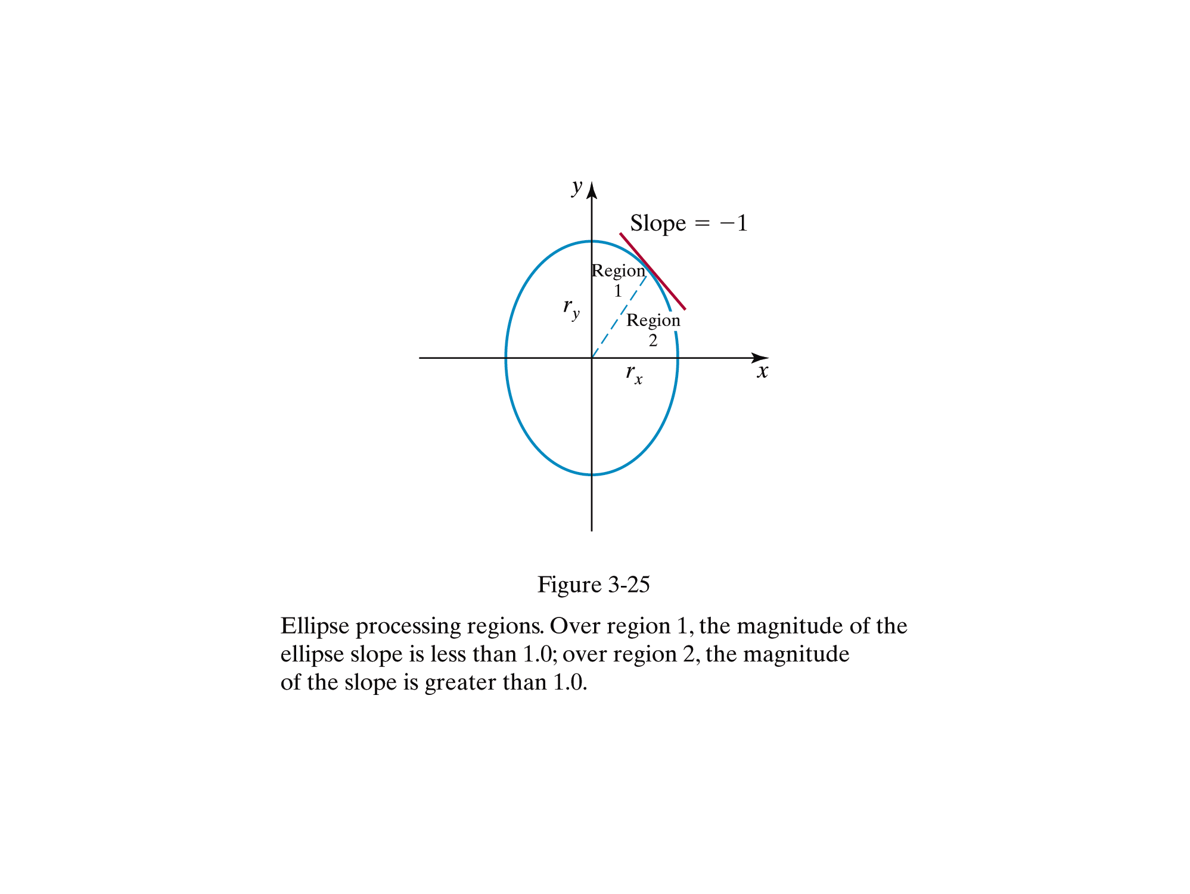
Figure shows the division of the first quadrant according to the slope of an ellipse with r_{x} < r_{y.}
We process this quadrant by taking unit steps in the x direction where the slope of the curve
has a magnitude < 1 and taking unit steps in the y direction where the slope has a magnitude > 1.

Slide 48

Equation of an ellipse
Consider an ellipse centered at the origin, (x_{c},y_{c})=(0,0):
Ellipse function
…and its properties:
f_{ellipse}(x,y) < 0 if (x,y) is inside the ellipse
f_{ellipse}(x,y) = 0 if (x,y) is on the ellipse
f_{ellipse}(x,y) > 0 if (x,y) is outside the ellipse

Slide 49
Midpoint Ellipse Algorithm
Ellipse is different from circle.
Similar approach with circle, different in sampling direction.
Region 1:
Sampling is at x direction
Choose between (x_{k}+1, y_{k}), or (x_{k}+1, y_{k}-1)
Move out if 2r_{y}²x >= 2r_{x}²y
Region 2:
Sampling is at y direction
Choose between (x_{k}, y_{k}-1), or (x_{k}+1, y_{k}-1)
Ellipse slope, dy / dx = - 2r_{y}²x / 2r_{x}²y
At the boundary between regions 1 & 2, dy / dx = -1 and 2r_{y}²x = 2r_{x}²y. Therefore we move out of region 1 whenever 2r_{y}²x >= 2r_{x}²y
Slope = -1
r_{y}
r_{x}
Region 1
Region 2

Slide 50
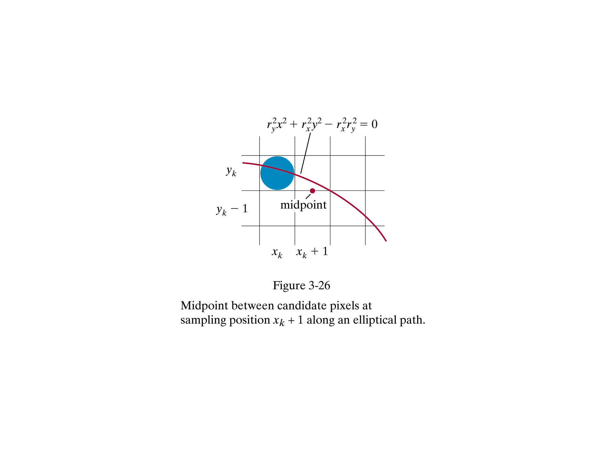

Slide 51
Assuming (x_{k}, y_{k}) has been selected at the previous step, we determine the next position along the ellipse path by evaluating the decision parameter at this midpoint
If p1_{k} < 0, the midpoint is inside the ellipse and the pixel on scan line y_{k} is closer to the ellipse boundary. Otherwise the midpoint is outside or on the ellipse boundary, and we select the pixel on scan line y_{k} – 1.
At the next sampling position (x_{k+1} + 1 = x_{k} + 2), the decision parameter for region 1 is evaluated as
where y_{k+1} is either y_{k} or y_{k+1}depending on the sign of p1_{k}.

Slide 52
Decision parameters are incremented by the following amounts:
As in circle algorithm, increments for the decision parameters can be calculated using only addition and subtraction, since values for the terms 2r_{y}²x and 2r_{x}²y can also be obtained incrementally. At the initial position (0, r_{y}), the two terms evaluate to
2r_{y}²x = 0 ……. (i) & 2r_{x}²y = 2r_{x}²r_{y} ……. (ii)
As x and y are incremented, updated values are obtained by adding 2r_{y}² to (i) and subtracting 2r_{x}² from (ii).

Slide 53
Updated values are compared at each step, and we move from region 1 to region 2 when 2r_{y}²x >= 2r_{x}²y
In region 1, initial value of decision parameter is obtained by evaluating the ellipse function at the start position (x₀, y₀) = (0, r_{y}):

Slide 54
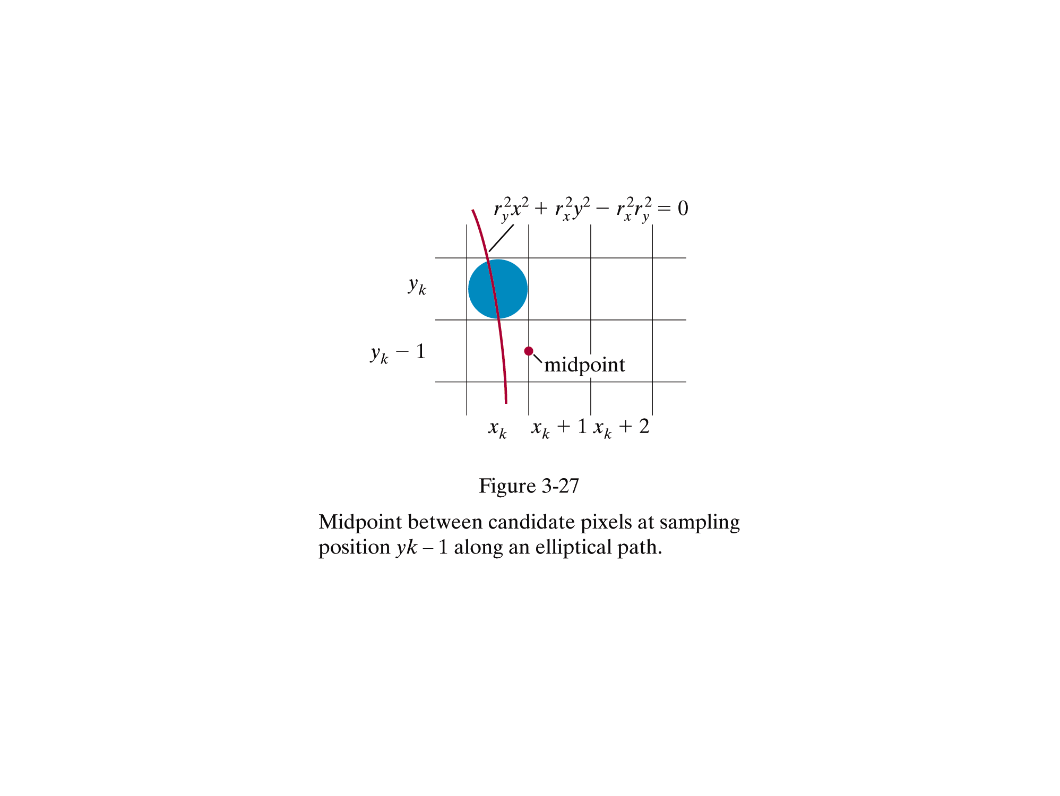
Over region 2, we sample at unit steps in the negative y direction, and the midpoint
is now taken between horizontal pixels at each step.

Slide 55
For region 2 the decision parameter is evaluated as
If p2_{k} > 0, the midpoint is outside the ellipse boundary, and we select the pixel at x_{k} . If p2_{k} <= 0, the midpoint is inside or on the ellipse boundary, and we select the pixel position x_{k+1} .
At the next sampling position (y_{k+1} - 1 = y_{k -} 2), the decision parameter for region 2 is evaluated as
where x_{k+1} is set either to x_{k} or to x_{k+1}depending on the sign of p2_{k}.

Slide 56
In region 2, initial value of decision parameter is obtained by evaluating the ellipse function at the initial position (x₀, y₀) that is the last position selected in region 1
To simplify the calculation of p2_{0,} we could select pixel positions in counterclock-wise order starting at (r_{x}, 0). Unit steps would then be taken in the positive y direction up to the last position selected in region 1.

Slide 57
Decision parameters
Region 1:
p1_{k} < 0:
midpoint is inside
choose pixel (x_{k+1}, y_{k})
p1_{k} >= 0:
midpoint is outside/on
choose pixel (x_{k+1}, y_{k}-1)
Region 2:
p2_{k} <= 0:
midpoint is inside/on
choose pixel (x_{k}+1, y_{k}-1)
p2_{k} > 0:
midpoint is outside
choose pixel (x_{k}, y_{k}-1)

Slide 58
Midpoint Ellipse Algorithm
Input r_{x}, r_{y} and ellipse center (x_{c}, y_{c}). Obtain the first point on an ellipse centered on the origin (0, 0), (x₀, y₀) = (0, r_{y}).
Calculate initial value for decision parameter in region 1 as:
At each x_{k} in region 1, starting from k = 0, test p1_{k} :
If p1_{k} < 0, next point (x_{k}+1, y_{k}) and
else, next point (x_{k+1}, y_{k}-1) and
with 2r_{y}²x_{k+1} = 2r_{y}²x_{k} + 2r_{y}², 2r_{x}²y_{k+1} = 2r_{x}²y_{k} – 2r_{x}²
and repeat step 3 until 2r_{y}²x ≥ 2r_{x}²y

Slide 59
Midpoint Ellipse Algorithm
Calculate the initial value for decision parameter in region 2 using the last point calculated in region 1 as:
where (x₀, y₀) is the last position calculate in region 1
5. At each y_{k} in region 2, starting from k = 0, test p2_{k}:
If p2_{k} > 0, next point is (x_{k}, y_{k}-1) and
else, next point is (x_{k}+1, y_{k}-1) and
continue until y=0

Slide 60
Midpoint Ellipse Algorithm
For both region determine symmetry points in the other 3 quadrants
Move each calculated pixel position (x,y) onto the elliptical path centered on (x_{c},y_{c}) and plot the coordinate values
x=x + x_{c}, y =y + y_{c}

Slide 61
Try this out!
Given input ellipse parameter r_{x}=8 and r_{y}=6, determine pixel positions along the ellipse path in the first quadrant using the midpoint ellipse algorithm.
Initial point for ellipse centered at origin is (x₀, y₀) = (0, 6)
2r_{y}²x = ?
2r_{x}²y = 2r_{x}²r_{y} = ?
p1₀ = ?
k | p1_{k} | (x_{k+1},y_{k+1}) | 2r_{y}² x_{k+1} | 2 r_{x}²y_{k+1}
0 | -332 | (1,6) | 72 | 768
1
2
3
4
5
6
k | p2_{k} | (x_{k+1},y_{k+1}) | 2r_{v}² x_{k+1} | 2 r_{x}²y_{k+1}
0
1
2

Slide 62
Try this out!
k | p1_{k} | (x_{k+1},y_{k+1}) | 2r_{y}² x_{k+1} | 2 r_{x}²y_{k+1}
0 | -332 | (1,6) | 72 | 768
1 | -224 | (2,6) | 144 | 768
2 | -44 | (3,6) | 216 | 768
3 | 208 | (4,5) | 288 | 640
4 | -108 | (5,5) | 360 | 640
5 | 288 | (6,4) | 432 | 512
6 | 244 | (7,3) | 504 | 384
Given input ellipse parameter r_{x}=8 and r_{y}=6,
Initial point for ellipse centered at origin is (x₀, y₀) = (0, 6)
2r_{y}²x = 0
2r_{x}²y = 2r_{x}²r_{y}
For region 2, initial point is (x₀, y₀) = (7, 3), and initial decision parameter is : -23 ,(8,2)
k | p2_{k} | (x_{k+1},y_{k+1}) | 2r_{v}² x_{k+1} | 2 r_{x}²y_{k+1}
0 |  | (8, 2)
1 |  | (8, 1)
2 |  | (8, 0) | ---- | ----

Slide 63
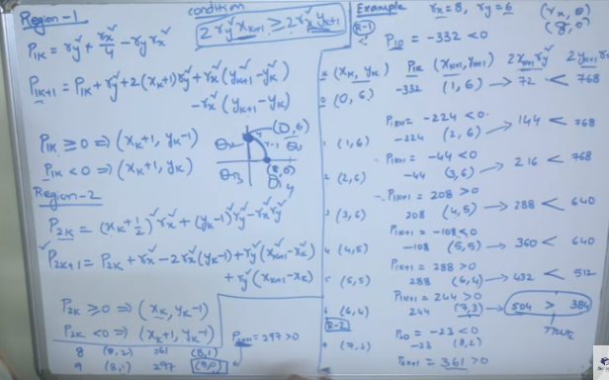

Slide 64
Plot pixel positions
6
5
4
3
2
1
0
 | 0 | 1 | 2 | 3 | 4 | 5 | 6 | 7 | 8

Slide 65
Speed Improvement
Parallel Curve Algorithm
. Like straight lines, parallel curve algorithms use segmentation and bounding rectangles.
. Curve segmentation
. Circle
. Divide the circular arc the upper octant into sub-arc segments.
. Assign the pixel calculations for each segment to a different processor.

Slide 66
Speed Improvement
. Ellipse
. Divide the elliptical arc in the first quadrant into sub-arc segment.
. Assign the pixel calculations for each segment to a different processor.

Slide 67
Assignment
Given two endpoints of a line are (2,4) and (100, 50) and 4 processors. Based on parallel line segmentation algorithm, determine the endpoints that each processor requires to draw these line segments simultaneously.

Slide 68
Conic Sections
Conic section (or conic) can be described with the second-degree equation:
Ax² + By² + Cxy + Dx + Ey + F = 0
Where values for A, B, C, D, E, and F determine the kind of curve we are to display.
B² + 4AC {< 0 generates an ellipse (or circle)
{ = 0 generates a parabola
{ > 0 generates a hyperbola
Eg. When A = B = 1, C = 0, D = -2x_{c}, E = -2y_{c}, and F = x_{c}² + y_{c}² ⁻ r², we get a circle

Slide 69
Other Curves
. Conic sections such as
Parabolas : y = y_{o} + a(x-x_{o})² + b(x-x₀)
a and b are constants determined by initial velocity v₀ and acceleration g (gravity)
Parabolic motions can be
determined with parametric equations using
parameter t (time – in second)
x = x₀ + v_{x0}t
y = y₀ + v_{yo}t – 0.5gt²
where v_{x0 and} v_{y0} are the initial velocity components,
and the value of g near the surface of the earth is
980cm/sec².
Object positions along the parabolic path are then
calculated at selected time steps.
V Velocity
Yo
G .gravity
Vo
Xo

Slide 70
Hyperbolic motions
Y = (r_{y} / r_{x}) x
(x / r_{x})² - (y / r_{y})² = 1
r_{y}
-r_{x}
r_{x}
-r_{y}

Slide 71
A polynomial function of n th degree in x is defined as
where n is a nonnegative integer and the a, k are constants, with a_{n} != 0. We obtain a quadratic curve when n = 2, a cubic polynomial when n = 3, a quartic curve when n = 4, and so forth. And we have a straight line when n = 1. Applications,
design of object shapes,
the specification of animation paths,
the graphing of data trends in a discrete set of data points.
Designing object shapes or motion paths is typically accomplished by first specifying a few points to define the general curve contour, then the selected points are fitted with a polynomial. One way to accomplish the curve fitting is to construct a cubic polynomial curve section between each pair of specified points.

Slide 72
Each curve section is then described in parametric form as
where parameter u varies over the interval from 0 to 1.0.
Values for the coefficients of u in the preceding equations are determined from boundary conditions on the curve sections.
Continuous curves that are formed with polynomial pieces are called spline curves, or simply splines.
Curve formed with individual cubic polynomial sections between specified coordinate positions.

Slide 73
Filling Polygons
So we can figure out how to draw lines and circles
How do we go about drawing polygons?
We use an incremental algorithm known as the scan-line algorithm

Slide 74
Fill area primitives(1)
useful picture components,
points, straight-line segments, and curves,…
an area that is filled with some solid color or pattern.
A picture component that is an area that is filled with some solid color or pattern is referred to as a fill area or a filled area.
Application
describe surfaces of solid objects,
fill regions are usually planar surfaces, mainly polygons.

Slide 75
Fill area primitives(2)
For the present,we assume that all fill areas are to be displayed with a specified solid color.
Solid-color fill areas specified with various boundaries.
(a)A circular fill region. (b)A fill area bounded by a closed poly line. (c)A filled area specified with an irregular curved boundary.

Slide 76
Fill area attribute(3)
Although any fill-area shape is possible, graphics libraries generally do not support specifications for arbitrary fill shapes.
Most library routines require that a fill area be specified as a polygon.
Graphics routines can efficiently process polygons because polygon boundaries are described with linear equations.
Most curved surfaces can be approximated with a set of polygon patches, just as a curved line can be approximated with a set of straight-line segments.

Slide 77
Fill area attribute(4)
When lighting effects and surface-shading procedures are applied, an approximated curved surface can be displayed quite realistically. Approximating a curved surface with polygon facets is sometimes referred to as surface tessellation, or fitting the surface with a polygon mesh.
Wire-frame views, shows only the polygon edges to give a general indication of the surface structure.
Then the wire-frame model could be shaded to generate a display of a natural-looking material surface.

Slide 78
Fill area primitives(5)
Objects described with a set of polygon surface patches are usually referred to as standard graphics objects, or just graphics objects.
Wire-frame representation for a cylinder, showing only the front (visible) faces of the polygon mesh used to approximate the surfaces.
In general, we can create fill areas with any boundary specification, such as a circle or connected set of spline-curve sections.

Slide 79
Filling Polygons
So we can figure out how to draw lines and circles
How do we go about drawing polygons?
We use an incremental algorithm known as the scan-line algorithm

Slide 80
Polygon
A polygon is a plane figure specified by a set of three or more coordinate positions, called vertices, that are connected in sequence by straight-line segments, called the edges or sides of the polygon.
the polygon edges have no common point other than their endpoints.

Slide 81
Polygon (1)
A polygon must have all its vertices within a single plane and there can be no edge crossings.
triangles, rectangles, octagons, and decagons.
Sometimes, any plane figure with a closed-polyline boundary is alluded to as a polygon, and one with no crossing edges is referred to as a standard polygon or a simple polygon.
“polygon” is referred only to those planar shapes that have a closed poly line boundary and no edge crossings.

Slide 82
For a computer-graphics application, it is possible that a designated set of polygon vertices do not all lie exactly in one plane.

Slide 83
Approximating a curved surface with a set of polygonal patches.
Divide the specified surface mesh into triangles.

Slide 84
Subdivision Method
Begin with a course approximation to the sphere, that uses only triangles
Two good candidates are platonic solids with triangular faces: Octahedron, Isosahedron
They have uniformly sized faces and uniform vertex degree
Repeat the following process:
Insert a new vertex in the middle of each edge
Push the vertices out to the surface of the sphere
Break each triangular face into 4 triangles using the new vertices
Octahedron
Isosahedron

Slide 85
Filled-Area Primitives
Two ways of area filling on raster system
1. By determining the overlaps intervals for scan lines that cross the area.
2. By starting from interior position outward until specified boundary condition is encountered.

Slide 86
Polygon Classifications
An interior angle of a polygon is an angle inside the polygon boundary formed by two adjacent edges
If all interior angles of a polygon are less than or equal to 180 degree, the polygon is said to be convex
If there is at least one interior angle greater than 180 degree, the polygon is said to be concave
The order of vertices for a polygon can be either clockwise or anti-clockwise

Slide 87
Filled-Area Primitives
. Polygon
- Concave
- Convex

Slide 88
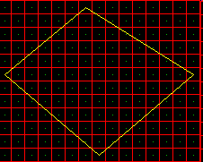
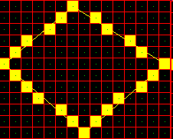
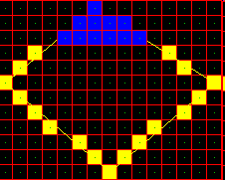
Polygon Scan-conversion
First scan convert all edges very coarsely, increment along y and don’t worry about gaps
For each scan line, fill between start and end pixel

Slide 89
Scan-Line Polygon Fill Algorithm
10
Scan Line
8
6
4
2
0
2
4
6
8
10
12
14
16

Slide 90
Scan-Line Polygon Fill Algorithm
The basic scan-line algorithm is as follows:
Find the intersections of the scan line with all edges of the polygon
Sort the intersections by increasing x coordinate
Fill in all pixels between pairs of intersections that lie interior to the polygon

Slide 91
Scan-Line Polygon Fill Algorithm (cont…)

Slide 92
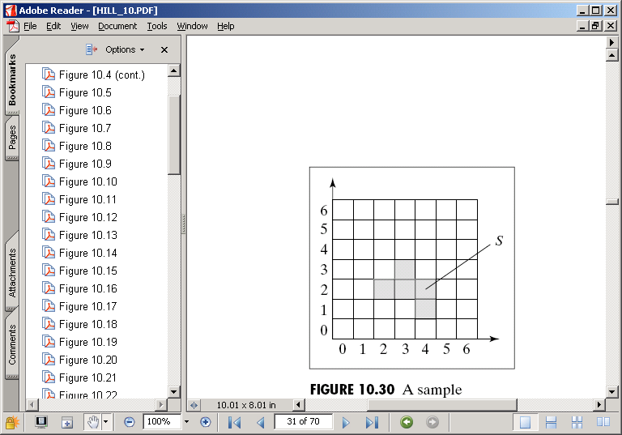
Area Filling
A simple recursive flood-fill algorithm: user selects a pixel S. S and all adjacent pixels of the same colour are changed, and the adjacent pixels of those etc… leads to some wasted processing
Recursive Flood Fill
Let orig_col = original colour of S
Let current_pixel = S
Change Colour of current_pixel to new_col
For all adjacent pixels p
IF (colour == orig_col)
THEN let p be the current_pixel
Repeat from Step 3

Slide 93
Inside-Outside Tests
Inside-Outside Tests.
. Filling means coloring a region
. How to identify interior or exterior region.
- Once determined only then interior to be filled accordingly.
. Two well known rules which decide the interior or exterior.
. Odd-even rule
. Non-zero winding rule.

Slide 94
Inside-Outside Tests
Odd-Even Rule
. Also known as odd-parity and even-odd rule.
. How it works?
. Pick a point of P in the region of interest.
. Draw a line from P to a distant point which lower than the smallest x.
. Move from P along the line to the distant point.
. Count the number of region edges the line crosses.
. If the number of polygon edges crossed is odd then P is inside the interior
region
. If the number of polygon edges crossed is even then P is inside the exterior
region.

Slide 95
Inside-Outside Tests
Non-Zero Winding Number Rule.
. Each boundary is given a direction number and then sum the numbers.
. Rules.
. The line chosen must not pass through any vertices.
. If first y value is less than second y value
Then give direction number –1.
. If first y value is greater than second y value
Then give direction number 1.
. Move from P along the line to the distant point.
. Add or minus based on the direction number when crossing the edges.
. Interior regions have non-zero winding numbers.
. Exterior regions have a winding number of 0.

Slide 96
Even odd Polygon Fill
When considering which spans on a scan line are “inside” the polygon for the even-odd rule, you simply “pair up” each intersection on a scan line (after sorting on x).
The non-zero winding rule is slightly more complicated.

Slide 97
Non-Zero Winding Rule Polygon Fill
Consider the vertex order as shown in the figure below.
Label each edge (i, i + 1 mod 5) with the values +1 or −1 depending on whether the edge is increasing or decreasing in y along that edge (remember that horizontal edges and edges between scan lines are omitted) (e.g., (0, 1) would be a +1 edge and (1, 2) would be a −1 edge).
The scan-line in the figure first intersects edge (4, 0) which is a −1 edge.
For each scan line sort the active edges according to ascending x-values.
Initialize a signed counter to zero and traverse each edge
and increment or decrement the counter according to the
associated sign.
Each time the sign becomes nonzero you have located the
left x-value of a span to fill – the corresponding edge that
returns the sign to zero yields the right x-value.
The idea is that the edges of the polygon “wind around”
each “inside” point 1 or more times.

Slide 98
Region Filling
Seed Fill Approaches
2 algorithms: Boundary Fill and Flood Fill
works at the pixel level
suitable for interactive painting apllications
Scanline Fill Approaches
works at the polygon level
better performance

Slide 99
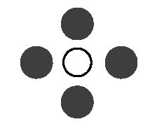
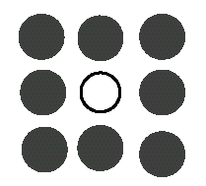
Seed Fill Algorithms: Connectedness
4-connected region: From a given pixel, the region that you can get to by a series of 4 way moves (N, S, E and W)
8-connected region: From a given pixel, the region that you can get to by a series of 8 way moves (N, S, E, W, NE, NW, SE, and SW)
4-connected
8-connected

Slide 100
Boundary-Fill Algorithm
In many graphics packages the user can fill a region (defined by a boundary).
In the figure, the boundary is red and the filling color is blue
The user needs to click inside the region (seed)

Slide 101
Boundary-Fill Algorithm
The fill method can be applied to a 4-connected area or to an 8-connected area

Slide 102
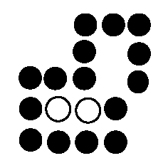
Boundary Fill Algorithm
Start at a point inside a region
Paint the interior outward to the edge
The edge must be specified in a single color
Fill the 4-connected or 8-connected region
4-connected fill is faster, but can have problems:

Slide 103
Boundary-Fill Algorithm
The following pseudo-code fills a 4-connected area:
boundaryFill(x, y, fill, boundary) {
current = getPixel(x, y)
If (current != boundary) and (current != fill) {
setPixel(x, y, fill)
boundaryFill(x+1, y, fill, boundary)
boundaryFill(x , y+1, fill, boundary)
boundaryFill(x-1, y, fill, boundary)
boundaryFill(x , y-1, fill, boundary)
}
Problem: the stack gets full very quickly
The following pseudo-code fills a 4-connected area:
boundaryFill(x, y, fill, boundary) {
current = getPixel(x, y)
flag = checkPointIsInside(x, y)
If (current != boundary) and (current != fill) and (flag == 1){
setPixel(x, y, fill)
boundaryFill(x+1, y, fill, boundary)
boundaryFill(x , y+1, fill, boundary)
boundaryFill(x-1, y, fill, boundary)
boundaryFill(x , y-1, fill, boundary)
}

Slide 104
Boundary-Fill Algorithm
Solution:
Draw horizontal pixel spans. While drawing, check above and below for the spans to be visited and store them in a stack.

Slide 105
Flood Fill Algorithm
Used when an area defined with multiple color boundaries
Start at a point inside a region
Replace a specified interior color (old color) with fill color
Fill the 4-connected or 8-connected region until all interior points being replaced

Slide 106
Flood Fill Algorithm (cont.)
void FloodFill4(int x, int y, color newcolor, color oldColor)
{
if(ReadPixel(x, y) == oldColor)
{
FloodFill4(x+1, y, newcolor, oldColor);
FloodFill4(x-1, y, newcolor, oldColor);
FloodFill4(x, y+1, newcolor, oldColor);
FloodFill4(x, y-1, newcolor, oldColor);
}
}

Slide 107
void main()
{ int x , y ,a[10][10]; int gd, gm ,n,i; detectgraph(&gd,&gm); initgraph(&gd,&gm,"c:\\tc\\bgi"); printf("\n\n\tEnter the no. of edges of polygon : "); scanf("%d",&n); printf("\n\n\tEnter the cordinates of polygon :\n\n\n "); for(i=0;i<n;i++) { printf("\tX%d Y%d : ",i,i); scanf("%d %d",&a[i][0],&a[i][1]); } a[n][0]=a[0][0]; a[n][1]=a[0][1]; printf("\n\n\tEnter the seed pt. : "); scanf("%d%d",&x,&y); cleardevice(); setcolor(WHITE); for(i=0;i<n;i++) /*- draw poly -*/ { line(a[i][0],a[i][1],a[i+1][0],a[i+1][1]); } fill_right(x,y); fill_left(x-1,y); getch(); }
void fill_right(int x, int y)
{ if(getpixel(x,y) == 0) { putpixel(x,y,RED); fill_right(++x,y); x = x - 1 ; fill_right(x,y-1); fill_right(x,y+1); }
}
void fill_left(int x, int y)
{ if(getpixel(x,y) == 0) { putpixel(x,y,RED); fill_left(--x,y); x = x + 1 ; fill_left(x,y-1); fill_left(x,y+1); }
}

Slide 108
4 way queue based Flood Fill
An explicitly queue-based implementation is shown in the pseudo-code below
Flood-fill (node, target-color, replacement-color)
1. Set Q to the empty queue.
2. If the color of node is not equal to target-color, return.
3. Add node to the end of Q.
4. While Q is not empty:
5. Set n equal to the first element of Q
6. If the color of n is equal to target-color, set the color of n to
replacement-color.
7. Remove first element from Q
8. If the color of the node to the west of n is target-color, set the color of that node to replacement-color, add that node to the end of Q.
9. If the color of the node to the east of n is target-color, set the color of that node to replacement-color, add that node to the end of Q.
10. If the color of the node to the north of n is target-color, set the color of that node to replacement-color, add that node to the end of Q.
11. If the color of the node to the south of n is target-color, set the color of that node to replacement-color, add that node to the end of Q.
12. Return.

Slide 109
4 way queue based Flood Fill
Most practical implementations use a loop for the west and east directions as an optimization to avoid the overhead of stack or queue management
Flood-fill (node, target-color, replacement-color):
Set Q to the empty queue.
If the color of node is not equal to target-color, return.
Add node to Q.
For each element n of Q:
If the color of n is equal to target-color:
Set w and e equal to n.
Move w to the west until the color of the node to the west of w no longer
matches target-color.
Move e to the east until the color of the node to the east of e no longer matches target-color.
Set the color of nodes between w and e to replacement-color.
For each node n between w and e:
If the color of the node to the north of n is target-color, add that node to Q.
If the color of the node to the south of n is target-color, add that node to Q.
Continue looping until Q is exhausted.
Return.

Slide 110
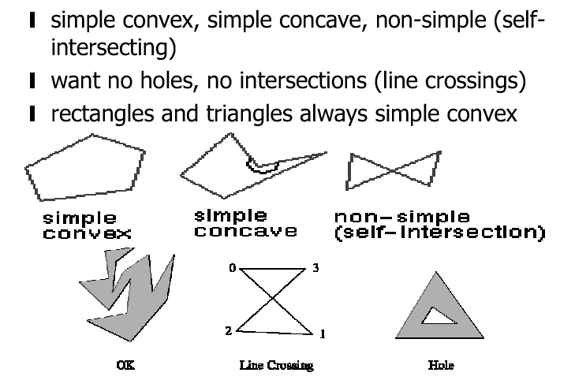
Polygon Types

Slide 111
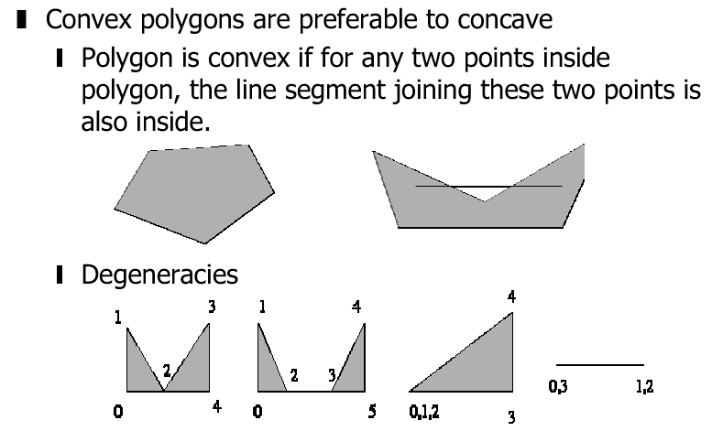
Convex, Concave, Degenerate

Slide 112
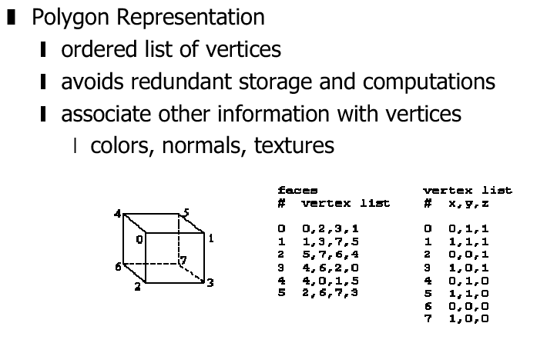
Polygon Representation

Slide 113
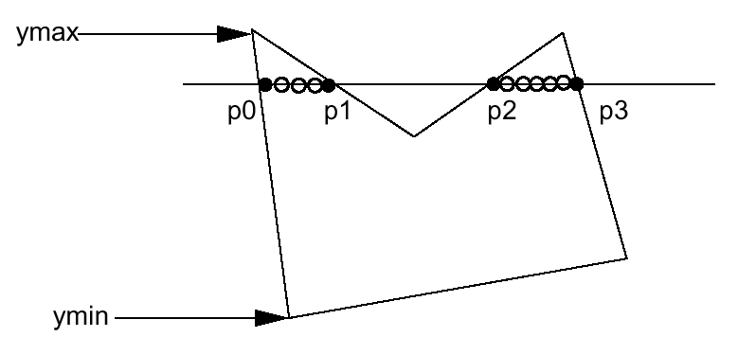
Scanline Fill Algorithm
Intersect scanline with polygon edges
Fill between pairs of intersections
Basic algorithm: For y = y_{min} to y_{max} 1) intersect scanline y with each edge 2) sort intersections by increasing x [p0,p1,p2,p3] 3) fill pairwise (p0->p1, p2->p3, …)

Slide 114
Filled-Area Primitives
Some special need handling on polygons intersection.
- Where vertex is the meeting point of two edges.
- If the two edges of vertex is on the same side – filling is no problem.
- If the two edges are on the opposite site – will cause some filling problem

Slide 115
Special Handling
Make sure we only fill the interior pixels Define interior: For a given pair of intersection points (Xi, Y), (Xj, Y) -> Fill ceilling(Xi) to floor(Xj) important when we have polygons adjacent to each other.

Slide 116
Special Handling (cont.)
Intersection has an integer X coordinate ->if Xi is integer, we define it to be interior ->if Xj is integer, we define it to be exterior (so don’t fill)

Slide 117
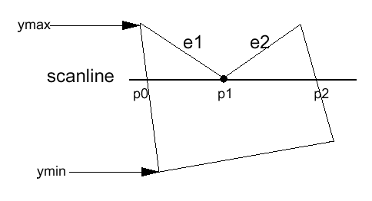
Special Handling (cont.)
Intersection is an edge end point
Case 1
Intersection points: (p0, p1, p2) ?
->(p0,p1,p1,p2) so we can still fill pairwise
->In fact, if we compute the intersection of the scanline with edge e1 and e2 separately, we will get the intersection point p1 twice. Keep both of the p1.

Slide 118
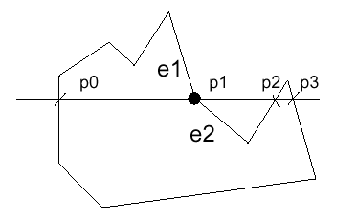
Special Handling (cont.)
Case 2
However, in this case we don’t want to count p1 twice (p0,p1,p1,p2,p3), otherwise we will fill pixels between p1 and p2, which is wrong.

Slide 119
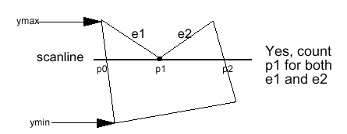
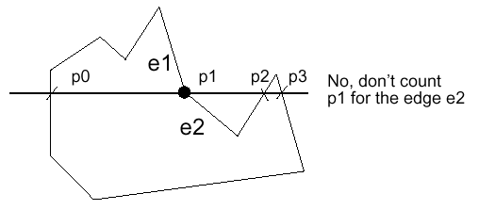
Special Handling (cont.)
Summary: If the intersection is the y_{min} of the edge’s endpoint, count it. Otherwise, don’t.

Slide 120
Basic Structure
For y=y_{min} to y_{max}
Intersect scanline with each edge
Sort Intersections by increasing x
Fill Pairwise
How to make sure it works correctly and fast?
Two important features:
Scanline Coherence: Values don’t change much from one scanline to next– the coverage (visibility) of a face on one scanline typically differs little from the previous one.
Edge Coherence: Edges intersected by scanline ‘s’ are typically intersected by scanline ‘l+1’.

Slide 121
Implementation using integer arithmetic
m = (y_{k+1} - y_{k})/(x_{k+1} - x_{k})
Intersection for next scanline is obtained as x_{k+1} = round(x_{k} + 1/m)
Eg. m=∆y/ ∆x=7/3
Set counter, c =0; & counter-increment, ∆c= ∆x=3
For the next three scanlines, successive values of c are: 3, 6, 9…
At 3rd scanline, c> ∆y
Then x is incremented by 1 only at 3rd scanline and set as c=c- ∆y= 9-7=2
Repeat above steps till y_{k} reaches y_{max}.
(x_{k+1}, y_{k+1})
L
(x_{k}, y_{k})
y_{k+1} = y_{k}+1
x_{k+1} = x_{k} + 1/m

Slide 122
Data Structure used
SET (Sorted Edge Table)
Built using bucket sort, with as many buckets as there are scanlines.
All edges are sorted by their y_{min} coordinate, with a separate y bucket for each scanline.
Within each buicket, edges are sorted by increasing x of y_{min} point.
Only non-horizontal edges are stored. Store these edges at the scanline position in the SET.
Edge Structure: Sample record for each scanline: (ymax, xmin, ∆x/ ∆y, pointer to next edge)

Slide 123
Data Structure used
AEL (Active Edge List)
Contains all edges crossed by a scanline at the current stage of iteration.
Contains list of edges that are active for this scanline, sorted by increasing x intersections.
Also called active edge table (AET).
AEL structure: (y_{max}, x, ∆x/ ∆y, pointer to next edge)

Slide 124
SET
Anti-clockwise traversal
BUCKET-sorted Edge Table for Polygon
12
11
10
09
08
07
06
05
04
03
02
01
12
11
10
09
08
07
06
05
04
03
02
01
D
F
11
10
9
8
7
6
5
4
3
2
1
0
Φ
Φ
(y_{max}, x_{min}, 1/m, *)
E
Φ
EF DE
Φ
C
9 7 -5/2
11 7 6/4 Φ
A
Φ
11 13 0 Φ
CD
B
Φ
9 2 0 Φ
FA
Φ
3 7 -5/2
5 7 6/4 Φ
Φ
AB BC

Slide 125
AET
(y_{max}, x, 1/m, *)
12
11
10
09
08
07
06
05
04
03
02
01
12
11
10
09
08
07
06
05
04
03
02
01
Status of AET at Scanline 8
FA
EF
DE
CD
D
F
9 2 0
E
C
9 4 -5/2
A
B
11 9 6/4
11 13 0 Φ

Slide 126
AET
(y_{max}, x, 1/m, *)
Now, y=ymax, throw out FA & EF
12
11
10
09
08
07
06
05
04
03
02
01
12
11
10
09
08
07
06
05
04
03
02
01
D
Status of AET at Scanline 9
FA
EF
DE
CD
F
9 2 0
E
C
9 2 -5/2
A
B
11 10 6/4
11 13 0 Φ

Slide 127
PRECAUTIONS
Intersection has an integer y coordinate
If this point is the y_{min} of the edges endpoint count it.
Count only non-horizontal edges
During each iteration process with a scanline, the AET is updated
For each scanline, AET keeps track of the set of edges it has to intersect & stores the intersection points. The sorting of the entries is w.r.t. the x-intersection values.

Slide 128
Processing steps
Set y to smallest y in SET entry (first non-empty bucket)
Initialize AET to be empty
Repeat until both AET & SET are empty
Move from SET bucket y to AET, those edges whose y_{min} = y
Sort AET on x (Simple as SET is pre-sorted)
Fill pixels on scanline y using pairs of x-coordinates from AET
Increment scanline by 1
Remove from AET those entries for which y=y_{max} (edges not involved)
For each non-vertical edge in AET, update x for new y
End loop

Slide 129
Algorithm
Construct Edge Table (ET)
Y_{min} =min (all y in the ET)
AET = NULL
For y=y_{min} to y_{max}
Merge-sort ET[y] into AET by x value
Fill between pairs of x in AET
For each edge in AET
If edge.y_{max} = y
Remove edge from AET
Else
edge.x = edge.x + dx/dy
End if
Sort AET by x valye
End

Slide 130
Character Generation
Overall design or style for set of characters is called type-face.
.Ex: Courier, Helvetica, New York.
Type-face are serif and san-serif (optima).
Serif type has small lines or accents at the ends of the main character strokes. Is more readable and hence easier to read in longer blocks of text
San-serif has not accents. Individual characters are easier to recognize and is therefore good for labeling and short headings
Font is originally referred to size and format.
Two different representation for storing fonts: Bitmapped Fonts & Outline
Fonts

Slide 131
Character Generation
Bitmapped Fonts:
.Characters represented as a rectangular grid or bits.
.Simple and quick to draw because character is mapped onto pixel positions in the frame buffer.
.However, it needs a lot of space. Each variation in size and style needs to be stored separately in a font cache.
.Can still generate different size and styles from a single bitmap but the results are poor quality because bitmap descriptions do not scale well.

Slide 132
Character Generation
Outline Fonts
.Characters described by straight lines and curves.
.Can generate different sizes and styles by manipulating curve definition.
. Slow because they must be scan converted into the frame buffer

Slide 133
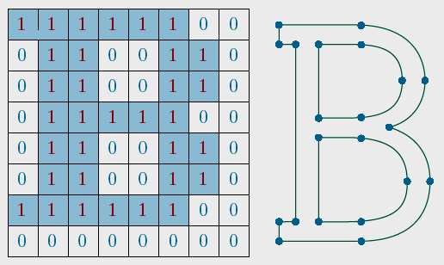
the letter B represented with an 8x8 bilevel bitmap pattern and with an outline shape defined with straight line and curve segments

Slide 134
Character Generation
So, between these two representation:
. Bitmapped are faster to draw than outline fonts
(simple to define and display), needs more space (font cache)
. Outline produce higher quality characters.
(more costly, less space, geometric transformations)

Slide 135
Assignments:
Implement the DDA & Bresenham’s line drawing algorithms (23rd Aug)
Implement the Mid-point circle & mid-point ellipse algorithms (27th Aug)
Implement the basic Boundary Fill algorithm for 4- & 8-connected regions. Start with a predefined region (stored as a sequence of coordinates in an array). Define a seed position. Display the filled region. Allow the user to define the region and to “plant the seed” inside. (30th Aug)
Write a program to draw a line graph. (30th Aug)
Write a program to display a pie chart with appropriate labeling. (30th Aug)
Write a program to display a bar chart with appropriate labelling. (30th Aug)
Extra credit: Write a program to scan convert the interior of a specified ellipse into a solid color. (30th Aug)

